Slide 1
SYSTEM DEVELOPMENT METHODOLOGY
EMoS 6308

Slide 2
Software process and practice:
Architecture design
Dr. Devotha Nyambo
‹#›
These slides are designed from Software Engineering 9^{/e} Addison Wesley 2011 by Ian Sommerville with some additional content
Notes:
‹#›

Slide 3
Architectural design
Architectural design is concerned with understanding how a system should be organized and designing the overall structure of that system
This is a critical link between design and requirements engineering
Defines main structures of the system and the relationship between them
It is a common practice in agile processes

Slide 4
Software architecture
The design process for identifying the sub-systems making up a system and the framework for sub-system control and communication is architectural design.
The output of this design process is a description of the software architecture.

Slide 5
Advantages of explicit architecture
Stakeholder communication
Architecture may be used as a focus of discussion by system stakeholders.
System analysis
Means that analysis of whether the system can meet its non-functional requirements is possible.
Large-scale reuse
The architecture may be reusable across a range of systems.

Slide 6
System structuring
Concerned with decomposing the system into interacting sub-systems.
The architectural design is normally expressed as a block diagram presenting an overview of the system structure.
More specific models showing how sub-systems share data, are distributed and interface with each other may also be developed.

Slide 7
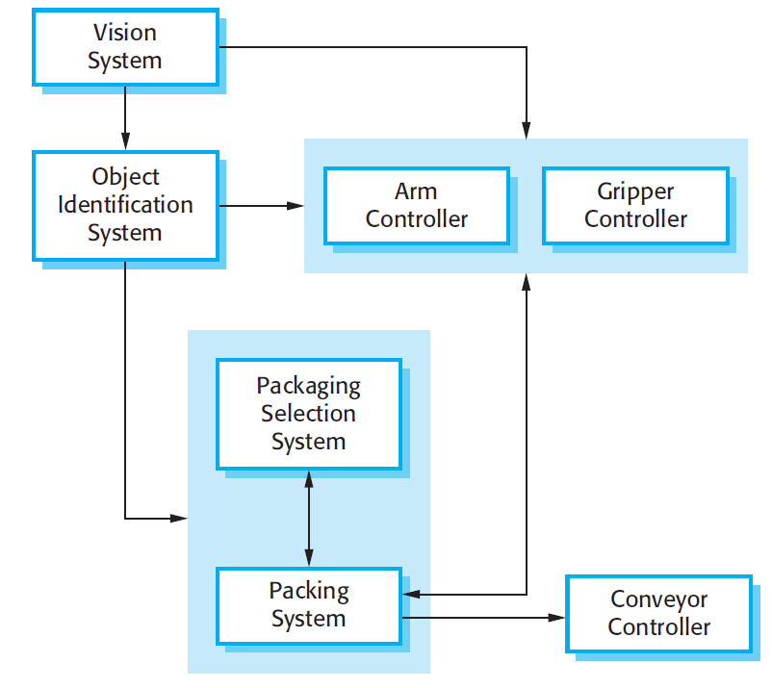
Packing robot control system

Slide 8
Box and line diagrams
Very abstract - they do not show the nature of component relationships nor the externally visible properties of the sub-systems.
However, useful for communication with stakeholders and for project planning.

Slide 9
Architectural design decisions
Architectural design is a creative process so the process differs depending on the type of system being developed.
However, a number of common decisions span all design processes.

Slide 10
Architectural design decisions
Is there a generic application architecture that can be used?
How will the system be distributed?
What architectural styles are appropriate?
What approach will be used to structure the system?
How will the system be decomposed into modules?
What control strategy should be used?
How will the architectural design be evaluated?
How should the architecture be documented?

Slide 11
Architecture reuse
Systems in the same domain often have similar architectures that reflect domain concepts.
Application product lines are built around a core architecture with variants that satisfy particular customer requirements.
Application architectures are covered in Chapter 13 and product lines in Chapter 18.

Slide 12
Architectural styles
The architectural model of a system may conform to a generic architectural model or style.
An awareness of these styles can simplify the problem of defining system architectures.
However, most large systems are heterogeneous and do not follow a single architectural style.

Slide 13
Non-functional requirements and system’s architecture
Performance: If performance is a critical requirement, the architecture should be designed to localize critical operations within a small number of components, with these components all deployed on the same computer rather than distributed across the network.
This may mean using a few relatively large components rather than small, fine-grain components, which reduces the number of component communications.

Slide 14
Security: If security is a critical requirement, a layered structure for the architecture should be used, with the most critical assets protected in the innermost layers, with a high level of security validation applied to these layers.
Safety: If safety is a critical requirement, the architecture should be designed so that safety-related operations are all located in either a single component or in a small number of components. This reduces the costs and problems of safety validation and makes it possible to provide related protection systems that can safely shut down the system in the event of failure.

Slide 15
Availability: If availability is a critical requirement, the architecture should be designed to include redundant components so that it is possible to replace and update components without stopping the system.
Maintainability: If maintainability is a critical requirement, the system architecture should be designed using fine-grain, self-contained components that may readily be changed

Slide 16
Potential Architectural conflict
There is potential conflict between some of these architectures. For example, using large components improves performance and using small, fine-grain components improves maintainability. If both performance and maintainability are important system requirements, then some compromise must be found. This can sometimes be achieved by using different architectural patterns or styles for different parts of the system.

Slide 17
Therefore...
Using large-grain components improves performance but reduces maintainability.
Introducing redundant data improves availability but makes security more difficult.
Localising safety-related features usually means more communication so degraded performance.

Slide 18
Architectural models
Used to document an architectural design.
Static structural model that shows the major system components.
Dynamic process model that shows the process structure of the system.
Interface model that defines sub-system interfaces.
Relationships model such as a data-flow model that shows sub-system relationships.
Distribution model that shows how sub-systems are distributed across computers.

Slide 19
System organisation
Reflects the basic strategy that is used to structure a system.
Three organisational styles are widely used:
A shared data repository style;
A shared services and servers style;
An abstract machine or layered style.

Slide 20
The repository model
Sub-systems must exchange data. This may be done in two ways:
Shared data is held in a central database or repository and may be accessed by all sub-systems;
Each sub-system maintains its own database and passes data explicitly to other sub-systems.
When large amounts of data are to be shared, the repository model of sharing is most commonly used.

Slide 21
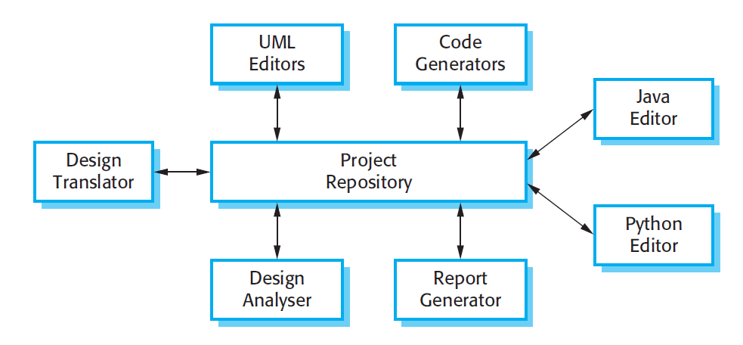
Eaxmpe of a repository model (an IDE model)

Slide 22
Repository model characteristics
Advantages
Efficient way to share large amounts of data;
Sub-systems need not be concerned with how data is produced Centralised management e.g. backup, security, etc.
Sharing model is published as the repository schema.
Disadvantages
Sub-systems must agree on a repository data model. Inevitably a compromise;
Data evolution is difficult and expensive;
No scope for specific management policies;
Difficult to distribute efficiently.

Slide 23
Client-server model
Distributed system model which shows how data and processing is distributed across a range of components.
Set of stand-alone servers which provide specific services such as printing, data management, etc.
Set of clients which call on these services.
Network which allows clients to access servers.

Slide 24
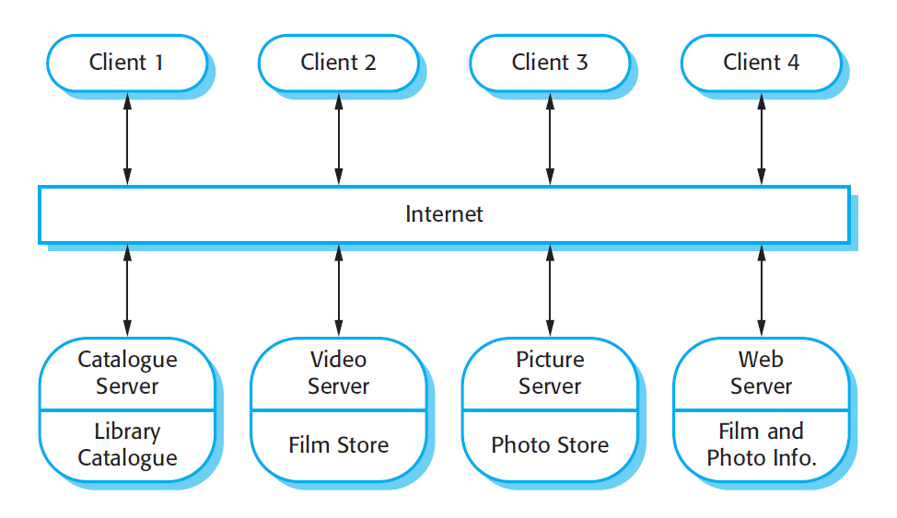
Film and picture library

Slide 25
Client-server characteristics
Advantages
Distribution of data is straightforward;
Makes effective use of networked systems. May require cheaper hardware;
Easy to add new servers or upgrade existing servers.
Disadvantages
No shared data model so sub-systems use different data organisation. Data interchange may be inefficient;
Redundant management in each server;
No central register of names and services - it may be hard to find out what servers and services are available.

Slide 26
Key points
The software architecture is the fundamental framework for structuring the system.
Architectural design decisions include decisions on the application architecture, the distribution and the architectural styles to be used.
Different architectural models such as a structural model, a control model and a decomposition model may be developed.
System organisational models include repository models, client-server models and abstract machine models.

